Slide 1
Fourier Transform (Practical)
Image Processing

Slide 2
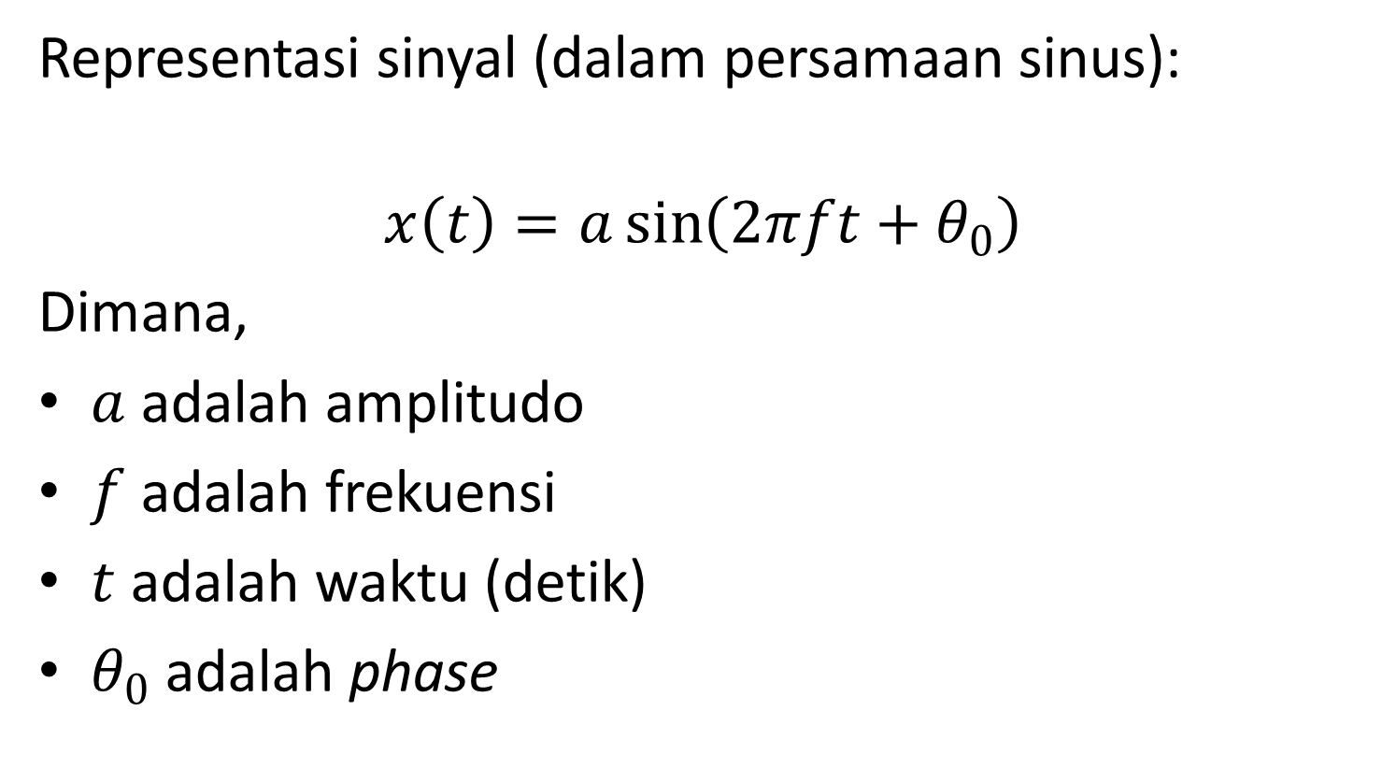
Sampling Signal

Slide 3
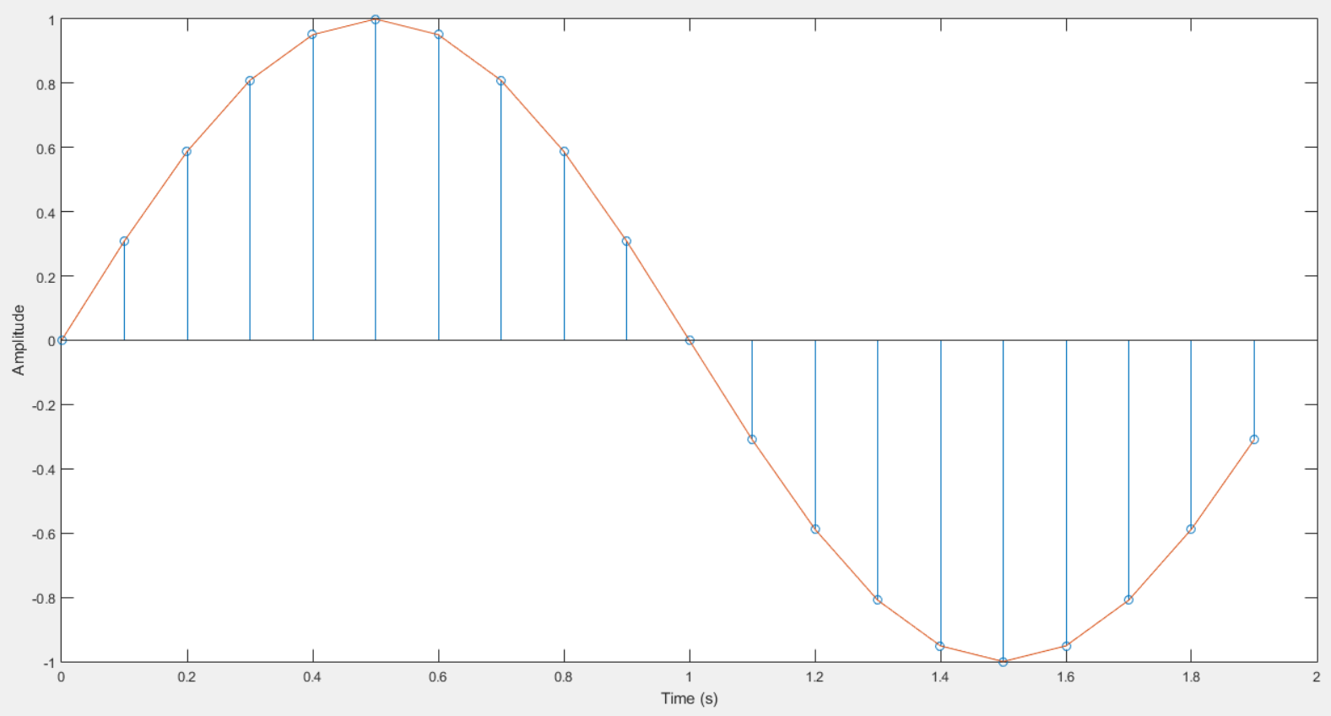
Sampling Signal

Slide 4
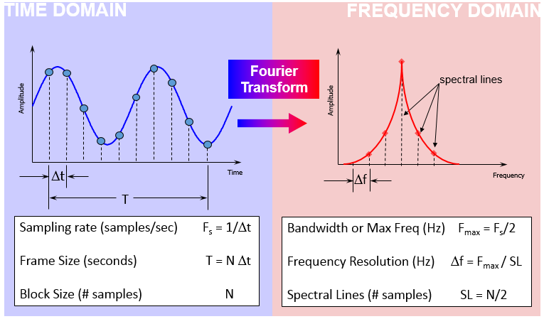
Sampling Signal
clear; clc;
%signal sampling fit
Fs = 10; %Sampling rate (Hz)
dt = 1/Fs; %delta t (time(s))
N = 2*Fs; %Sampling number
t = (0:N-1)*dt; %time(s)
%The signal
A = 1; %Amplitude
n = 1; %scale of Frequency
F = 0.5; %Frequency
theta = 0*pi; %phase
xt = A*sin(2*pi*n*F*t + theta);
stem(t, xt); hold on; plot(t, xt);
xlabel('Time (s)'); ylabel('Amplitude');

Slide 5
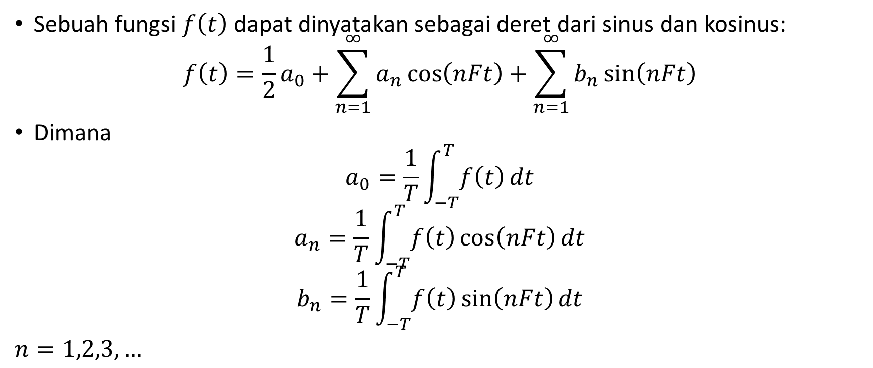
Deret Fourier
Sebuah fungsi $f\left(t\right)$ dapat dinyatakan sebagai deret dari sinus dan kosinus:
$$f\left(t\right)=\frac{1}{2}a_{0}+\sum_{n=1}^{∞}{a_{n}}\cos\left(nFt\right)+\sum_{n=1}^{∞}{b_{n}}\sin\left(nFt\right)$$
Dimana
$$a_{0}=\frac{1}{T}\int_{−T}^{T}{f\left(t\right)}dt$$
$$a_{n}=\frac{1}{T}\int_{−T}^{T}{f\left(t\right)}\cos\left(nFt\right)dt$$
$$b_{n}=\frac{1}{T}\int_{−T}^{T}{f\left(t\right)}\sin\left(nFt\right)dt$$
$n=1,2,3,…$

Slide 6
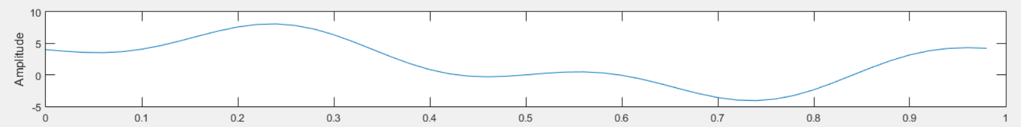
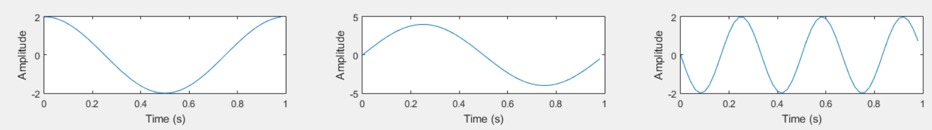
Fourier Series
$$x\left(t\right)=2+2\cos{2πFt}+4\sin{2πFt}−2\sin{6πFt}$$
%signal sampling fit
Fs = 50; %Sampling rate (Hz)
dt = 1/Fs; %delta t (time(s))
N = 1*Fs; %Sampling number
t = (0:N-1)*dt; %time(s)

Slide 7
Fourier Series
F = 1;
xt(1,:) = 2*cos(2*pi*F*t);
xt(2,:) = 4*sin(2*pi*F*t);
xt(3,:) = -2*sin(6*pi*F*t);
xT = zeros(size(xt(1,:)));
xT = xT + 2;
for i=1:3
xT = xT + xt(i,:);
end
subplot(2, 3, 1),plot(t, xt(1,:));xlabel('Time (s)’);ylabel('Amplitude');
subplot(2, 3, 2),plot(t, xt(2,:));xlabel('Time (s)’);ylabel('Amplitude');
subplot(2, 3, 3),plot(t, xt(3,:));xlabel('Time (s)');ylabel('Amplitude');
subplot(2, 3, [4 6]), plot(t, xT);xlabel('Time (s)');ylabel('Amplitude');

Slide 8
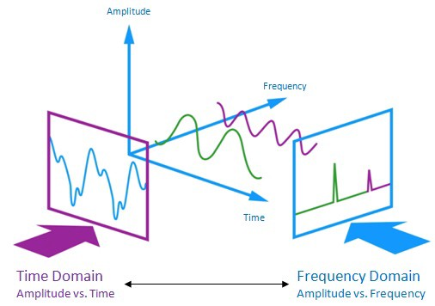
Time vs Frequency Domain

Slide 9

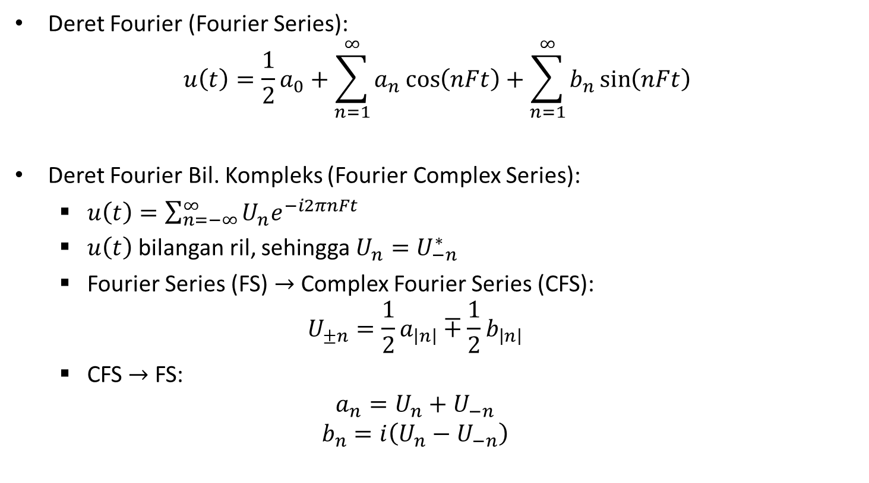
Transformasi Fourier
Deret Fourier (Fourier Series):
$$u\left(t\right)=\frac{1}{2}a_{0}+\sum_{n=1}^{∞}{a_{n}}\cos\left(nFt\right)+\sum_{n=1}^{∞}{b_{n}}\sin\left(nFt\right)$$
Deret Fourier Bil. Kompleks (Fourier Complex Series):
$u\left(t\right)=\sum_{n=−∞}^{∞}{U_{n}e^{−i2πnFt}}$
$u\left(t\right)$ bilangan ril, sehingga $U_{n}=U_{−n}^{∗}$
Fourier Series (FS) $→$ Complex Fourier Series (CFS):
$$U_{±n}=\frac{1}{2}a_{\left|n\right|}∓\frac{1}{2}b_{\left|n\right|}$$
CFS $→$ FS:
$$a_{n}=U_{n}+U_{−n}$$
$$b_{n}=i\left(U_{n}−U_{−n}\right)$$
$$U_{n}^{∗} konjugat dariU_{n}$$

Slide 10
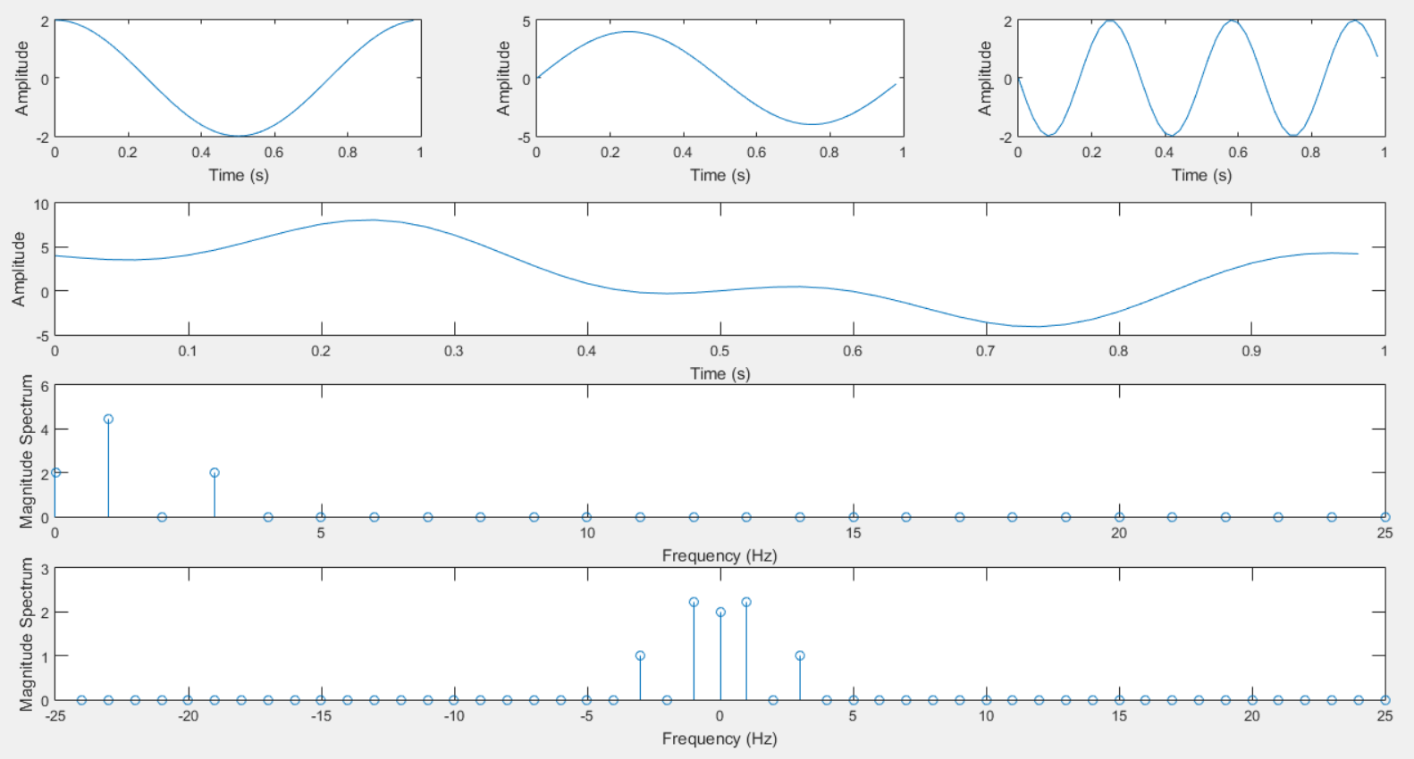
Fourier Transform in 1D

Slide 11
Fourier Transform in 1D
XT = fft(xT);
Mag = abs(XT/N);
Mag1 = Mag(1:N/2+1);
Mag1(2:end-1) = 2*Mag1(2:end-1);
Fmax = Fs/2;
SL = N/2;
df = Fmax/SL;
f1 = (0:Fmax)*df;
subplot(4, 3, [7 9]), stem(f1, Mag1);
xlabel('Frequency (Hz)'); ylabel('Magnitude Spectrum');
f2 = (-Fmax+1:Fmax)*df;
Mag2 = zeros(size(Mag));
Mag2(N/2:N) = Mag(1:N/2+1);
Mag2(1:N/2-1) = Mag(N/2+2:end);
subplot(4, 3, [10 12]), stem(f2, Mag2);
xlabel('Frequency (Hz)'); ylabel('Magnitude Spectrum');

Slide 12
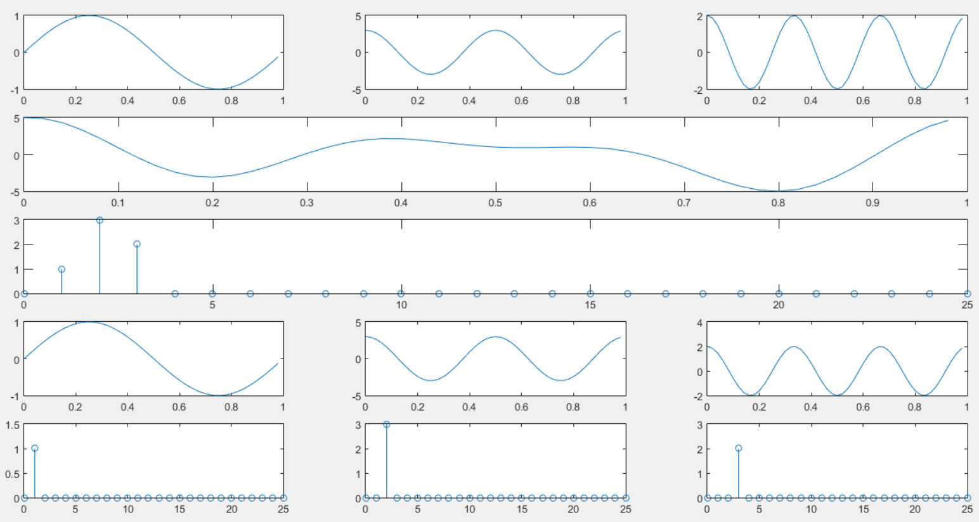
1D Signal Decomposition

Slide 13
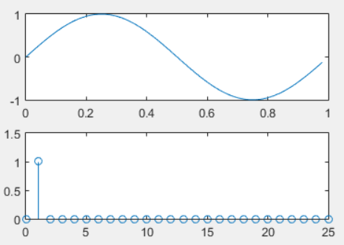
1D Signal Decomposition
XTn1 = XT;
XTn1(2+1) = 0;
XTn1(3+1) = 0;
XTn1(end+1-2) = 0;
XTn1(end+1-3) = 0;
xtn1 = ifft(XTn1);
subplot(5, 3, 10), plot(t, xtn1);
Magn2 = abs(XTn1/N);
Magn1 = Magn2(1:N/2+1);
Magn1(2:end-1) = 2*Magn1(2:end-1);
subplot(5, 3, 13), stem(f, Magn1);

Slide 14
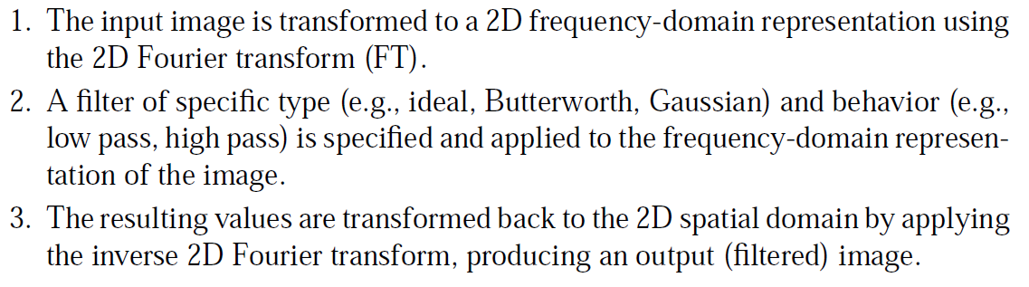
Fourier Transform 2D

Slide 15
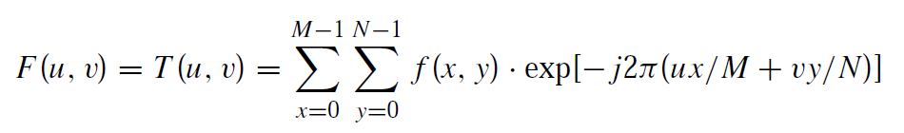
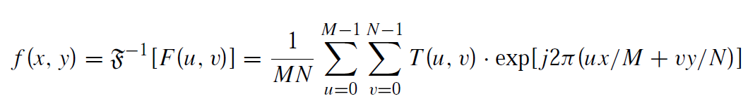
Fourier Transform 2D
Discrete Fourier Transform (DCT):
Invers Discrete Fourier Transform (iDCT):

Slide 16
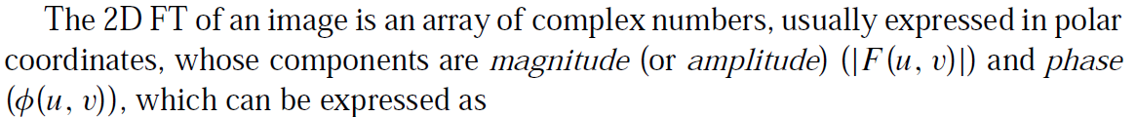
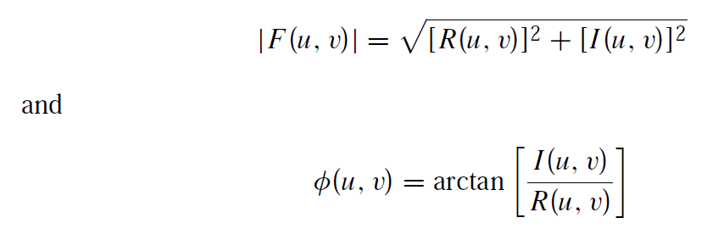
Magnitude and Phase

Slide 17

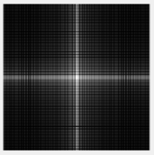
DCT 2D
clear; clc;
I = zeros(300);
I(125:175,100:200) = 1;
ft = fft2(I);
ft_shift = fftshift(ft);
ftv = log(1+abs(ft_shift));
figure, imshow(I);
Figure, imshow(ftv,[]);

Slide 18
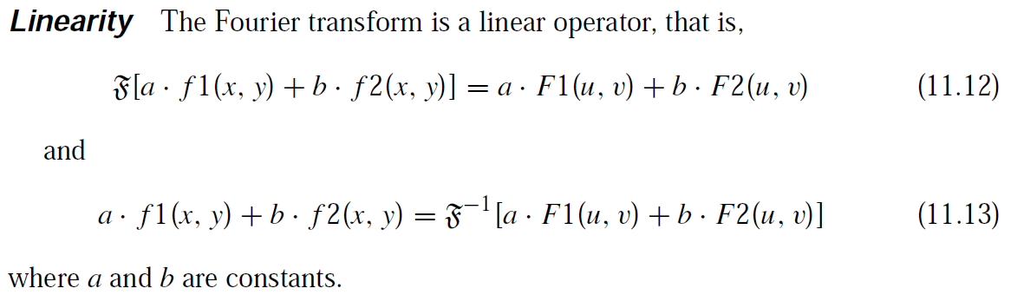
Properties of Fourier Transform #1

Slide 19
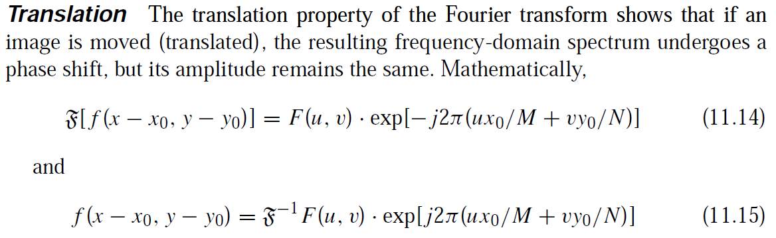
Properties of Fourier Transform #2

Slide 20
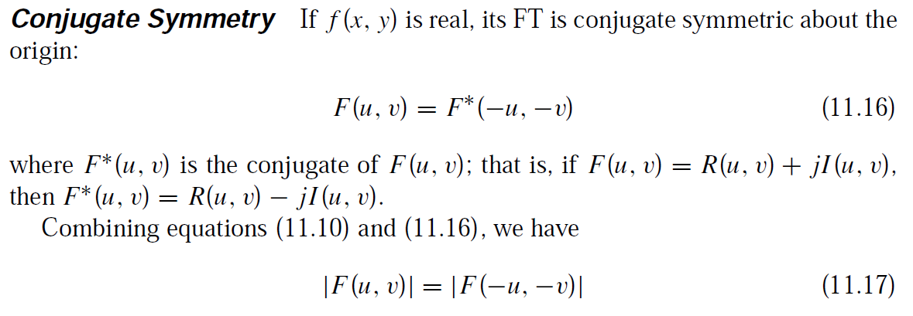
Properties of Fourier Transform #3

Slide 21
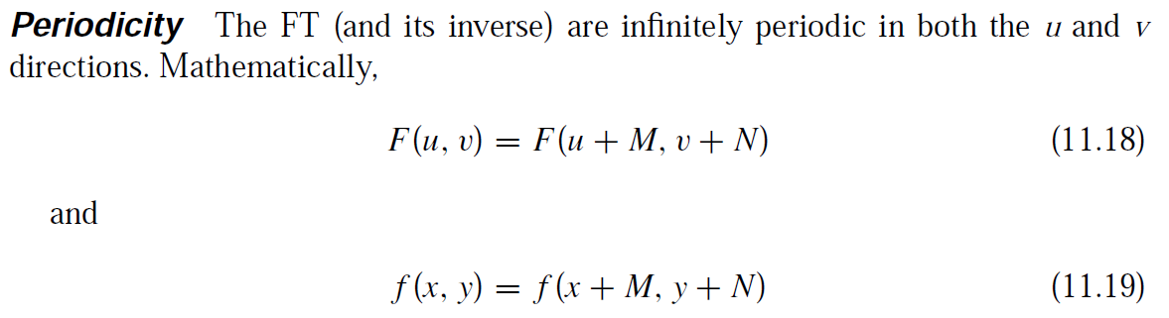
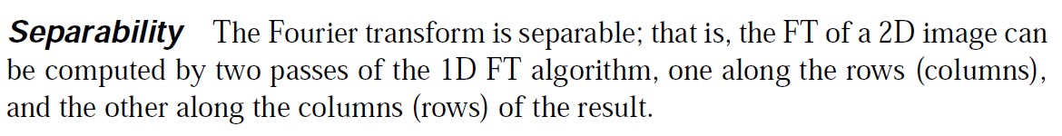
Properties of Fourier Transform #4-5

Slide 22
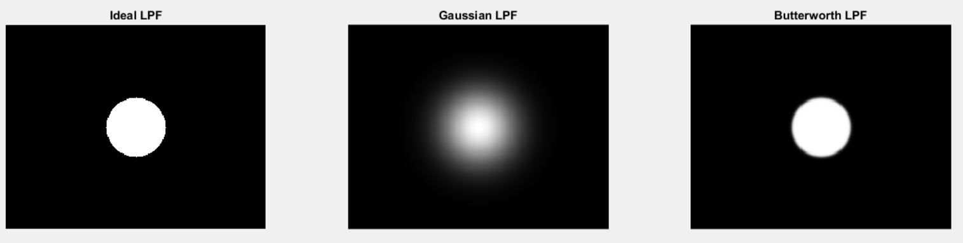
Low-Pass Filter (LPF)
Ideal LPF
Gaussian LPF
Butterworth

Slide 23
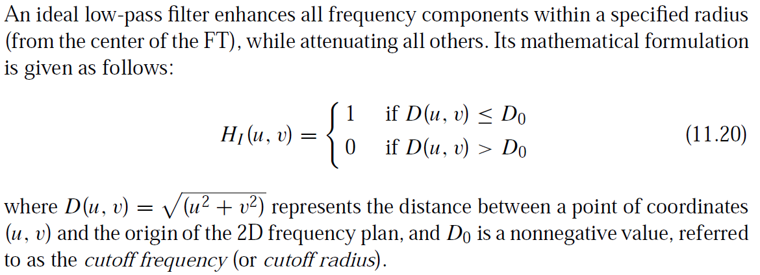
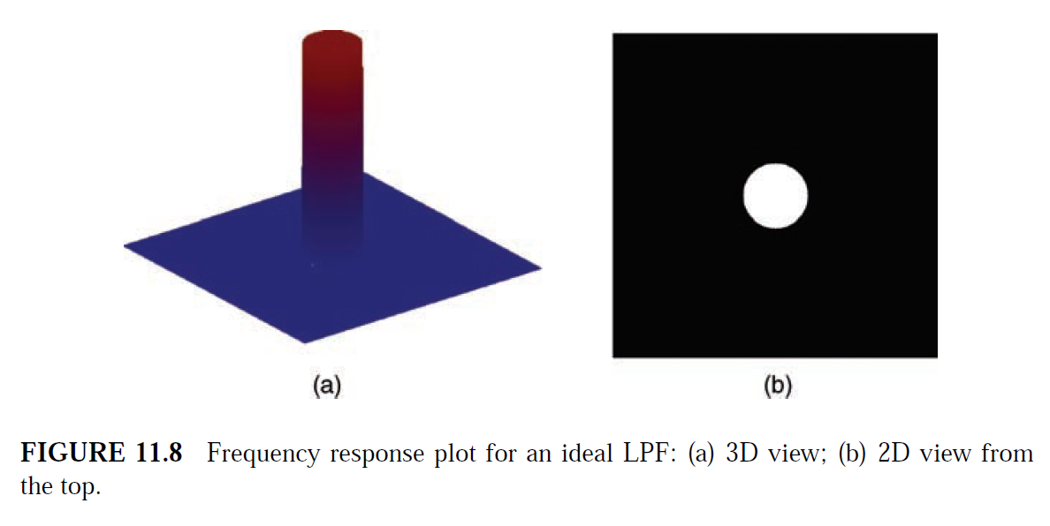
Ideal LPF

Slide 24
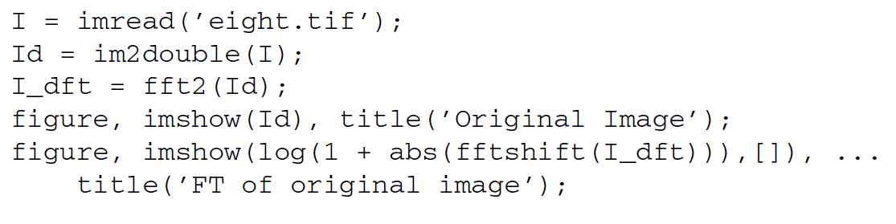
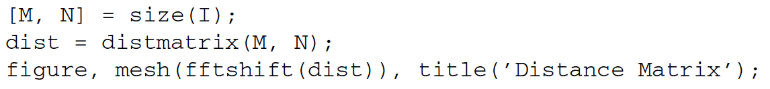
Fourier Transform

Slide 25

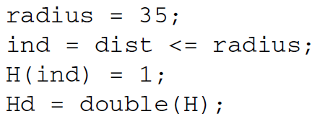

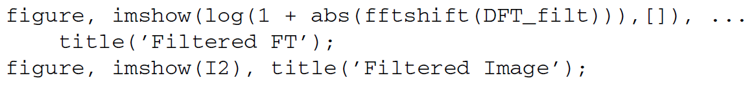
Ideal LPF

Slide 26
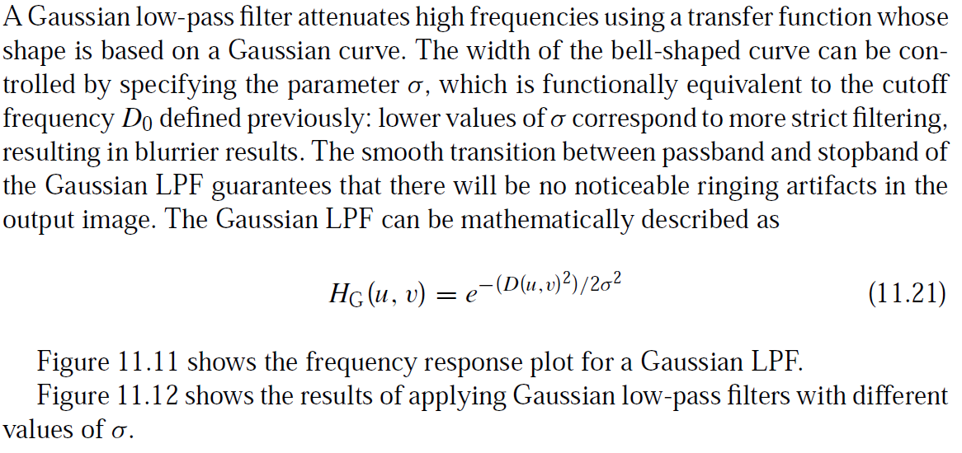
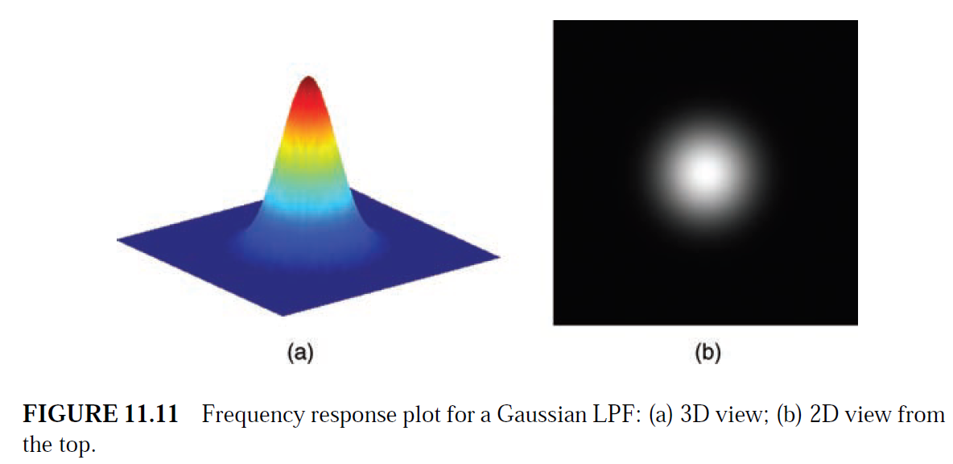
Gaussian LPF

Slide 27
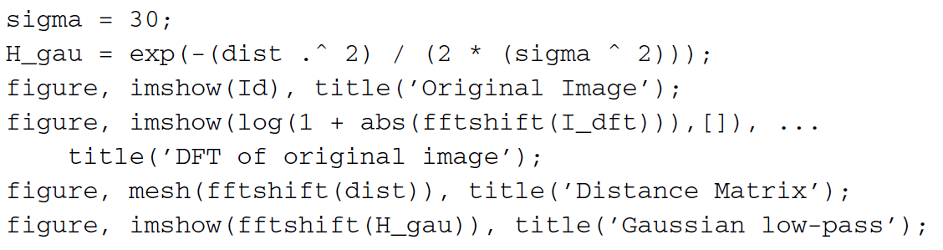
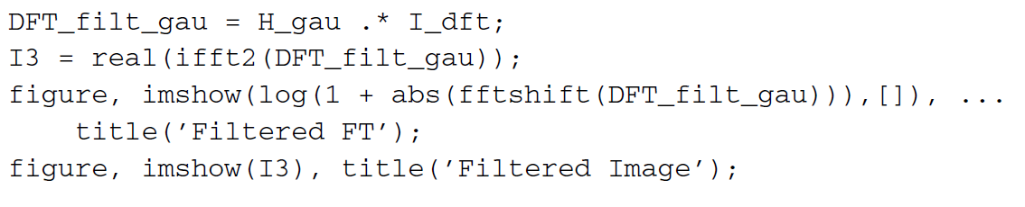
Gaussian LPF

Slide 28
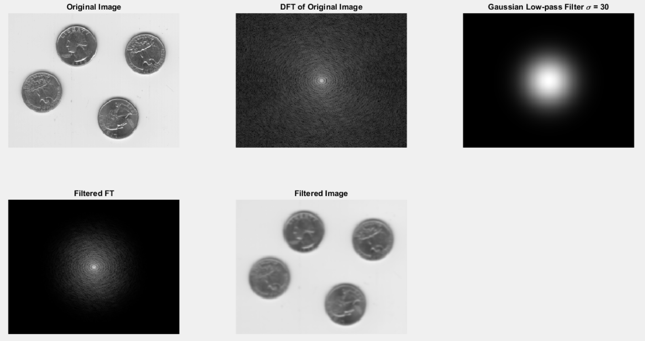
Gausian LPF

Slide 29
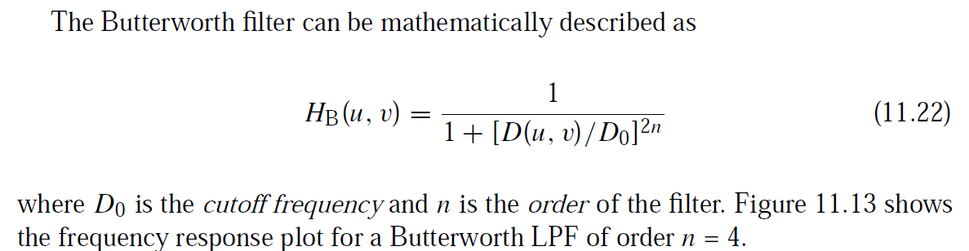
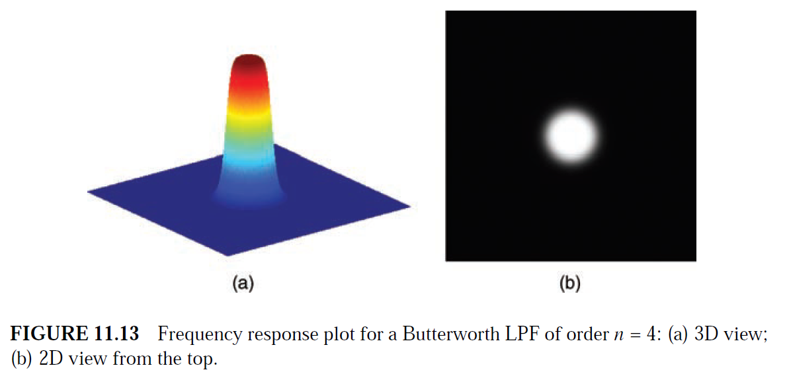
Butterworth LPF

Slide 30
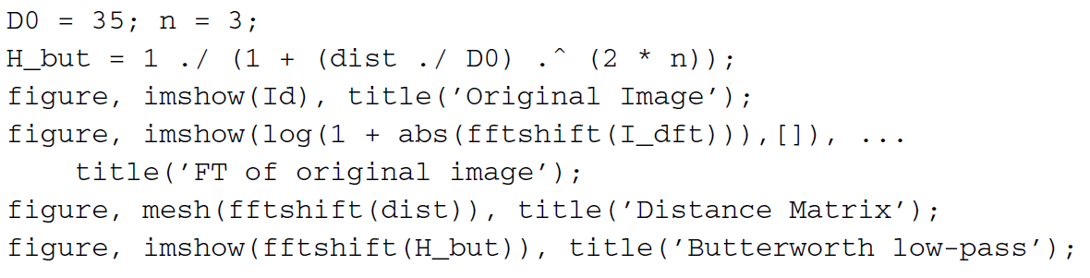
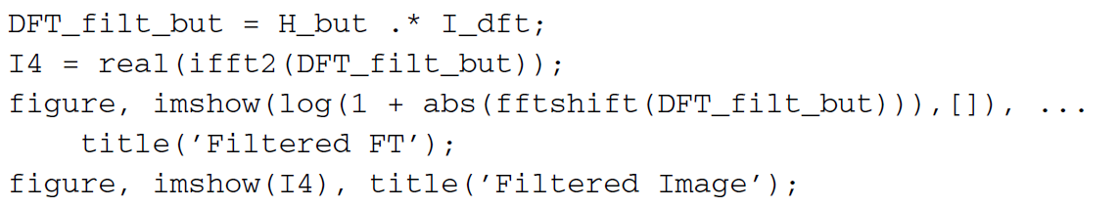
Butterworth LPF

Slide 31
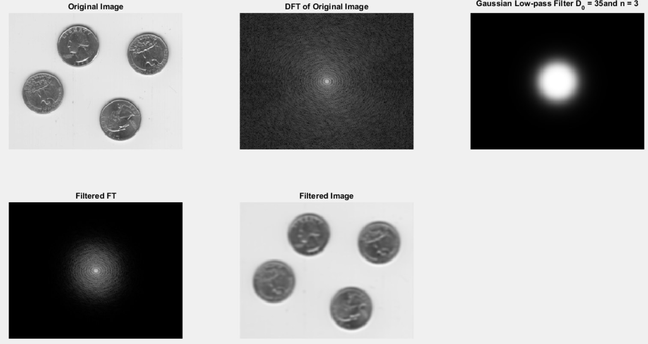
Butterworth LPF

Slide 32
High-Pass Filter HPF
Ideal HPF
Gaussain HPF
Butterworth HPF

Slide 33
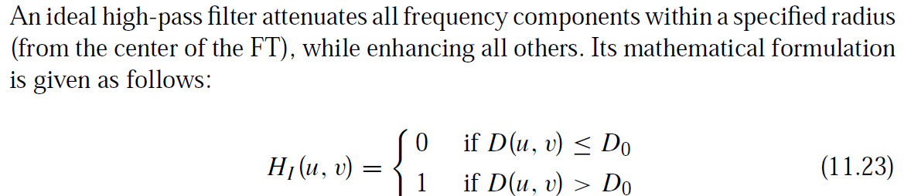
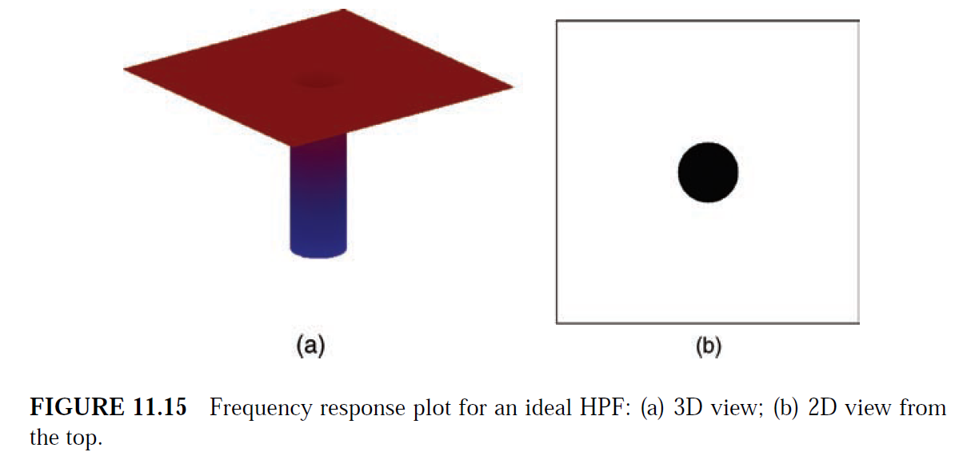
Ideal HPF

Slide 34
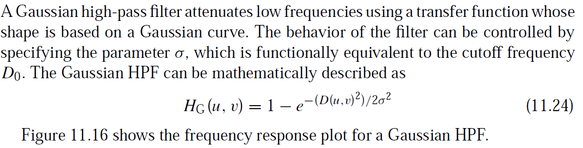
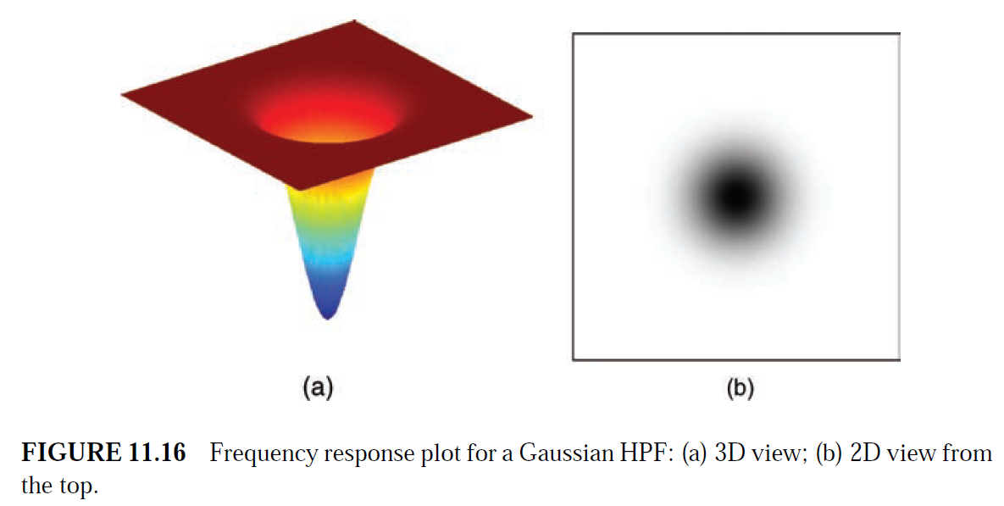
Gaussian HPF

Slide 35
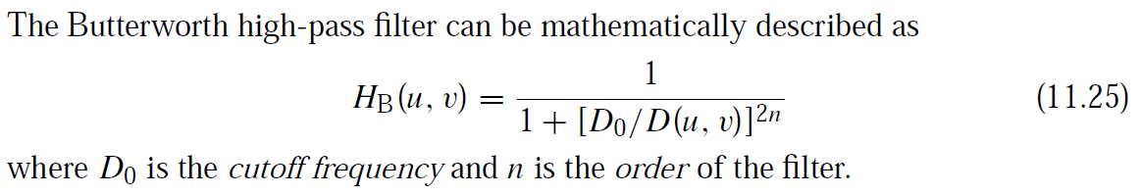
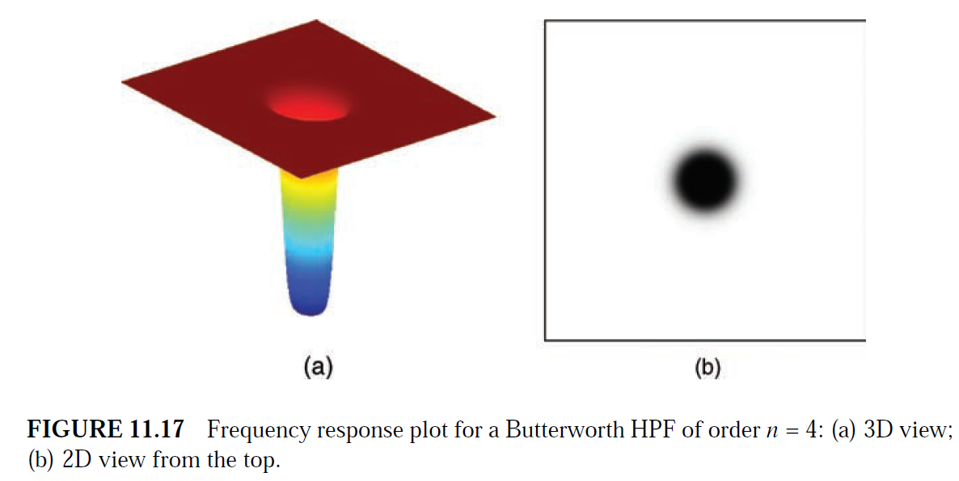
Butterworth HPF

Slide 36
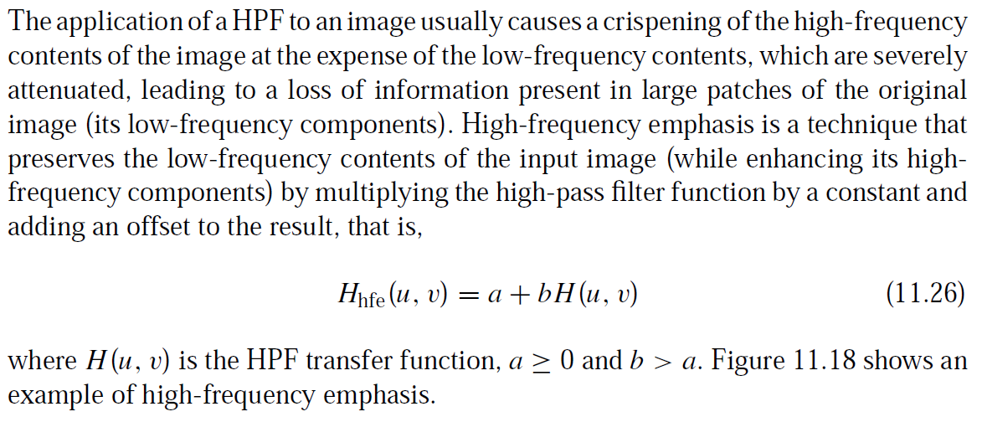
High Frequency Emphasis

Slide 37
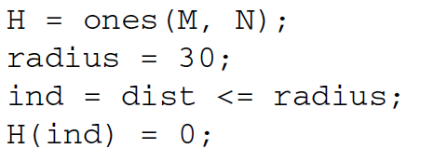

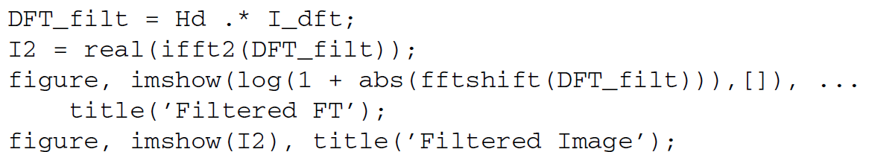
Ideal HPF

Slide 38
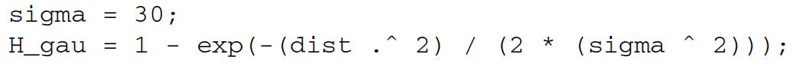
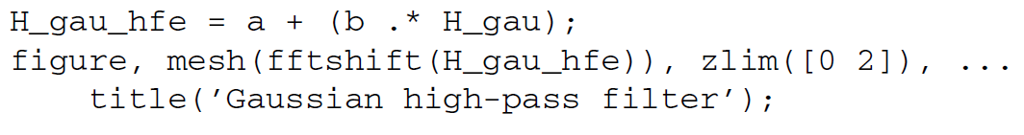

Gaussian HPF

Slide 39


Butterworth HPF

